Slide 1
Chapter 6: Process Synchronization

Slide 2
Module 6: Process Synchronization
Background
The Critical-Section Problem
Peterson’s Solution
Synchronization Hardware
Semaphores
Classic Problems of Synchronization

Slide 3
Objectives
To introduce the critical-section problem, whose solutions can be used to ensure the consistency of shared data
To present both software and hardware solutions of the critical-section problem
To introduce the concept of an atomic transaction and describe mechanisms to ensure atomicity

Slide 4
Background
Concurrent access to shared data may result in data inconsistency
Maintaining data consistency requires mechanisms to ensure the orderly execution of cooperating processes
Suppose that we wanted to provide a solution to the consumer-producer problem that fills all the buffers. We can do so by having an integer count that keeps track of the number of tems in buffers. Initially, count is set to 0. It is incremented by the producer after it produces a new buffer and is decremented by the consumer after it consumes a buffer.

Slide 5

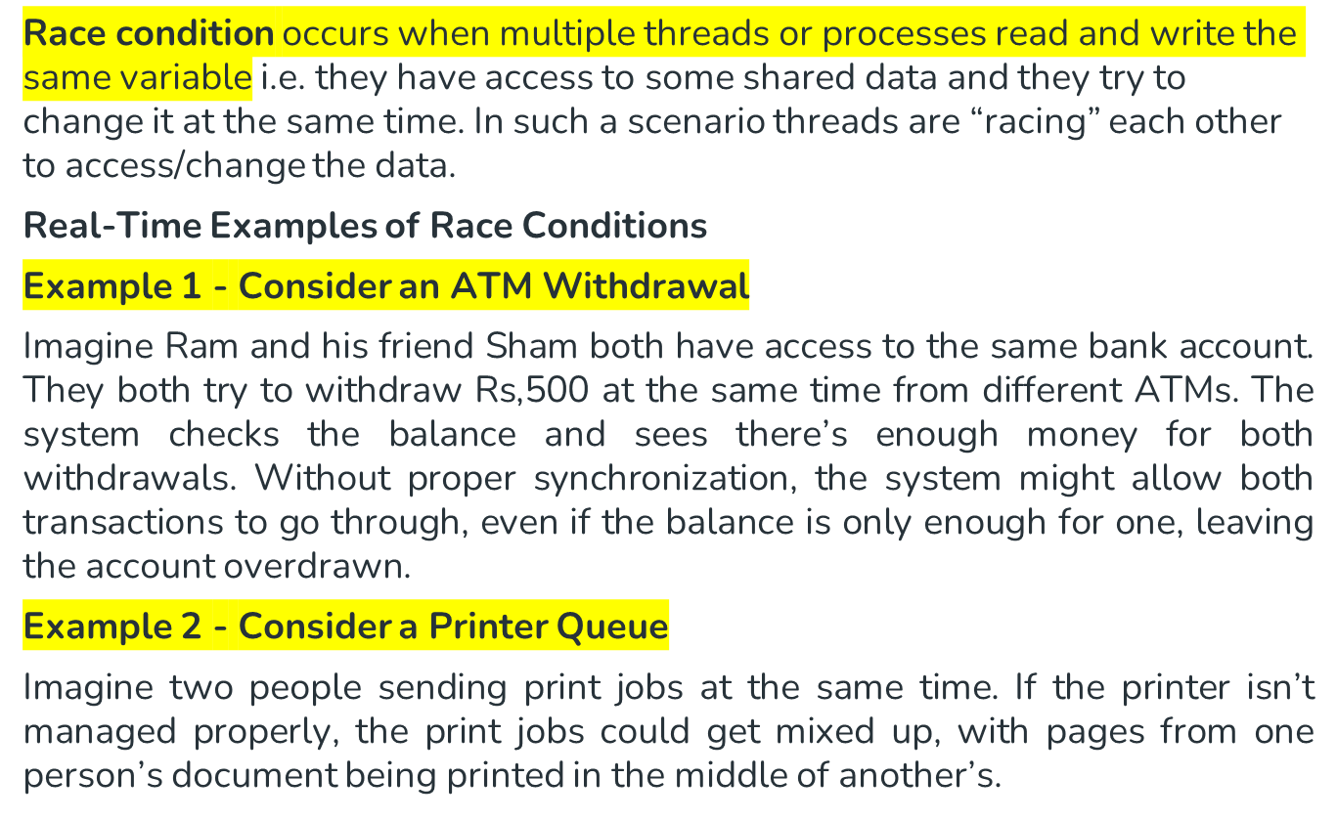

Slide 6
Race Condition
count++ could be implemented as
register1 = count
register1 = register1 + 1
count = register1
count-- could be implemented as
register2 = count
register2 = register2 - 1
count = register2
Consider this execution interleaving with “count = 5” initially:
  S0: producer execute register1 = count {register1 = 5}
  S1: producer execute register1 = register1 + 1 {register1 = 6}
  S2: consumer execute register2 = count {register2 = 5}
  S3: consumer execute register2 = register2 - 1 {register2 = 4}
  S4: producer execute count = register1 {count = 6 }
  S5: consumer execute count = register2 {count = 4}

Slide 7
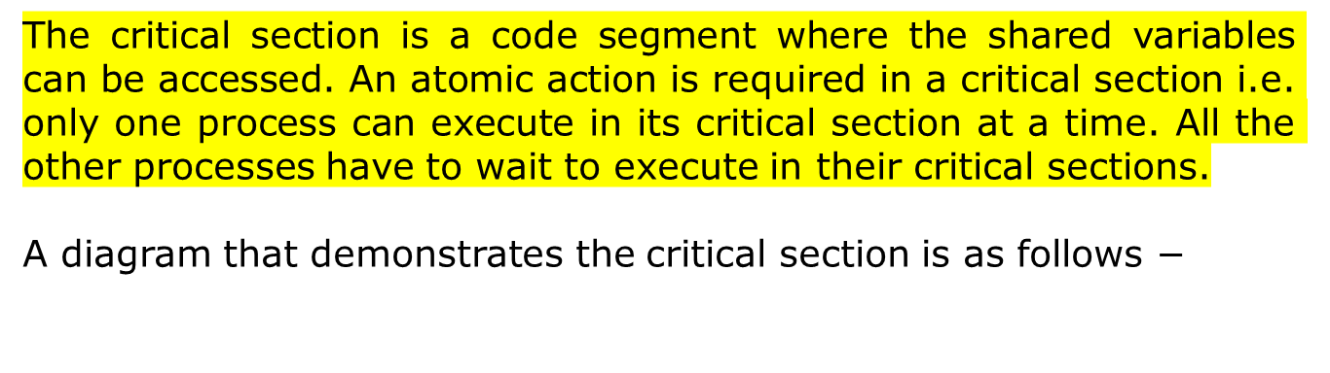
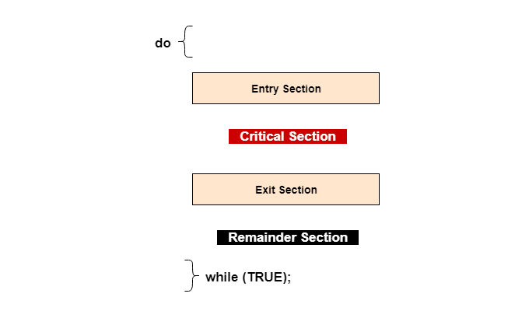
Critical-Section Problem
Critical section is place where shared variables, resources are placed.(common of two programs)
The part which are not shared will be part of non-critical section.

Slide 8
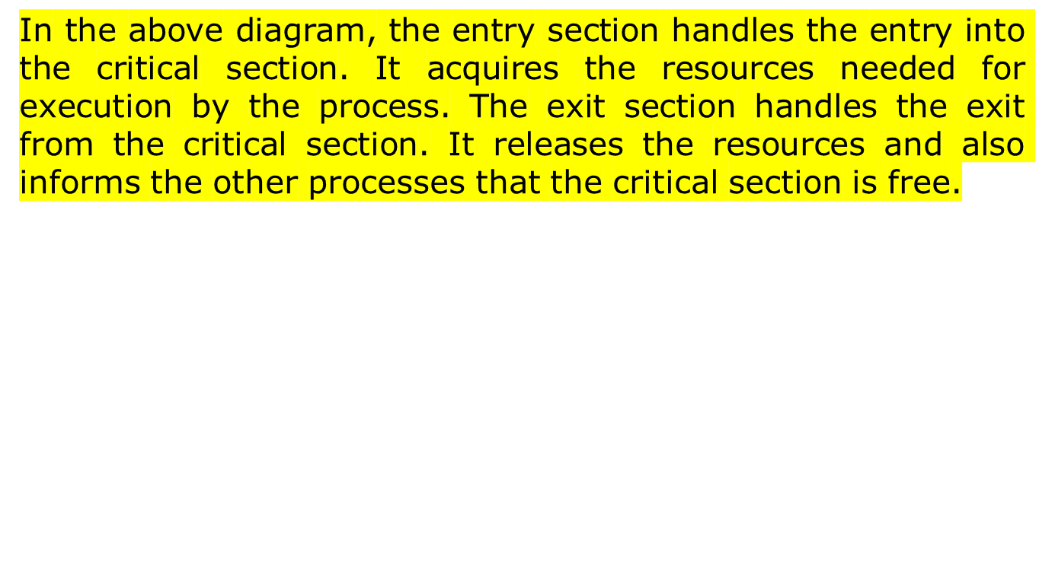
Critical-Section Problem

Slide 9

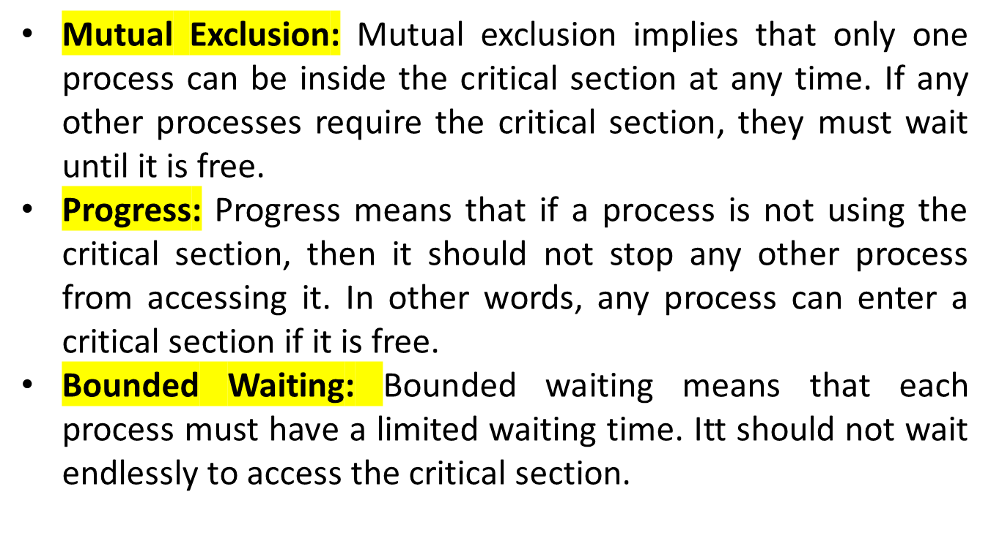

Slide 10

Two process solution
Assume that the LOAD and STORE instructions are atomic; that is, cannot be interrupted.
The two processes share two variables:
  int turn;
  Boolean flag[2]
The variable turn indicates whose turn it is to enter the critical section.
The flag array is used to indicate if a process is ready to enter the critical section. flag[i] = true implies that process P_{i} is ready!

Slide 11
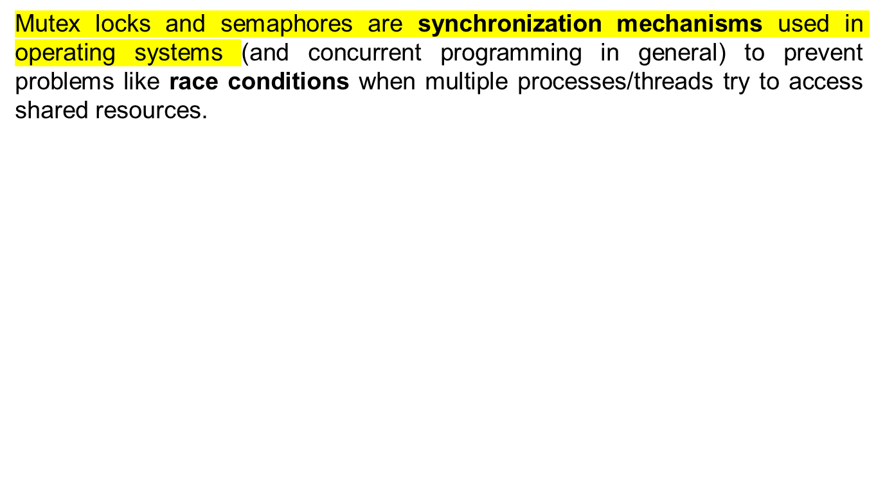
Mutex Locks and Semaphores

Slide 12

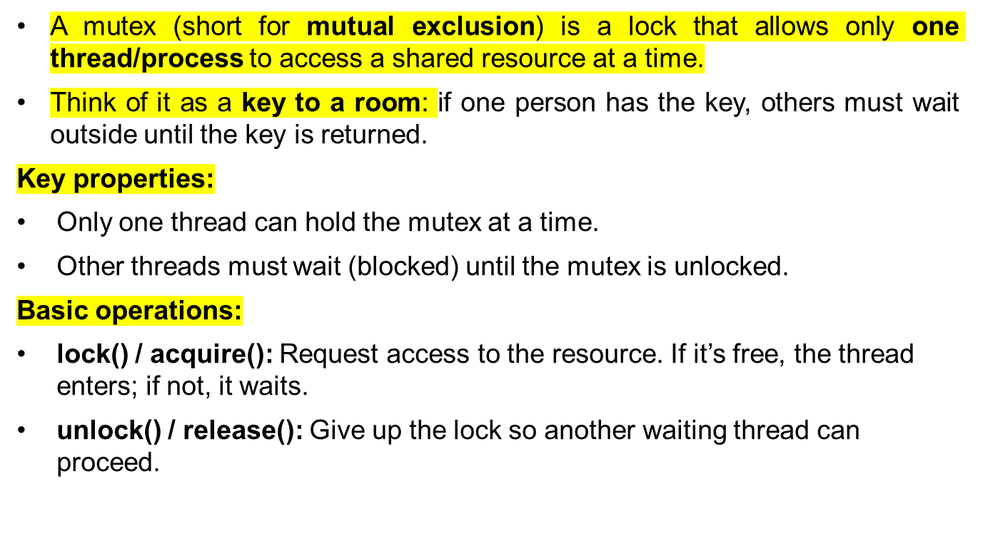

Slide 13

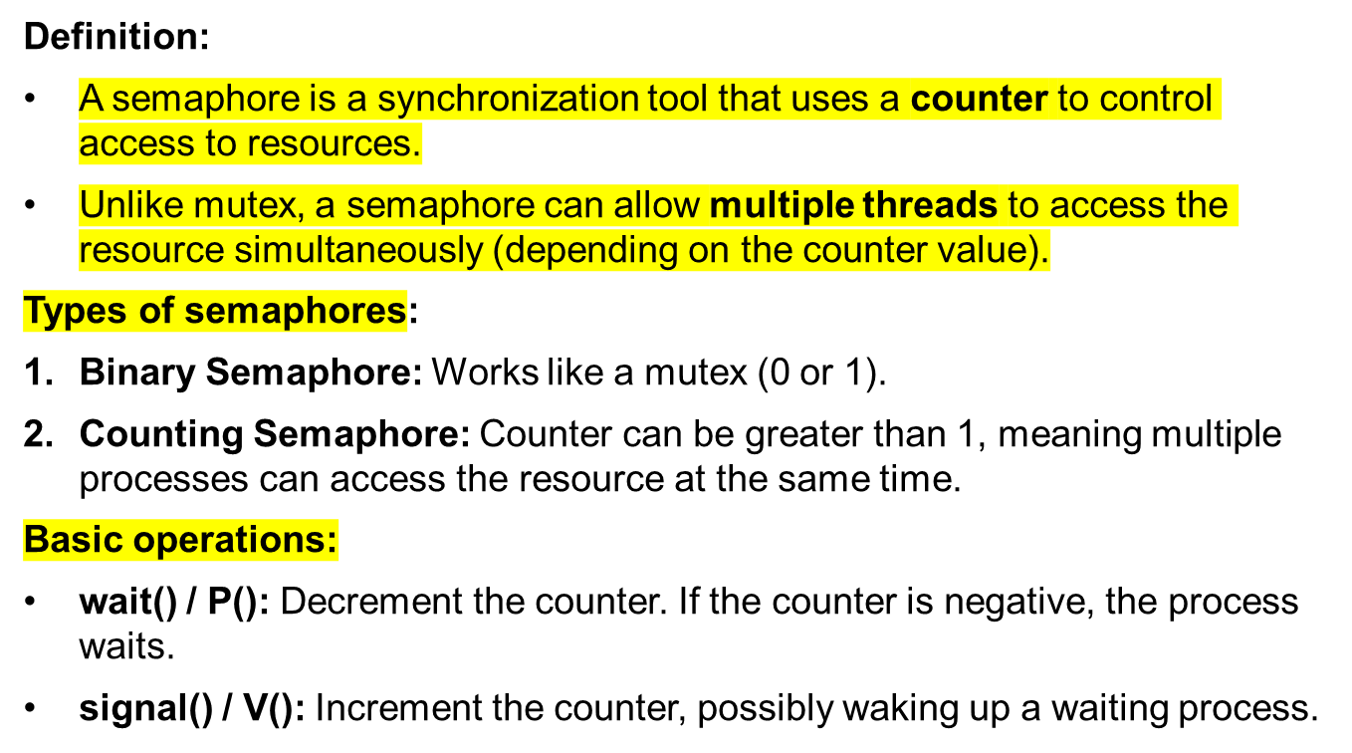

Slide 14
Semaphore
Example (Real-life):
Imagine a parking lot with 3 parking spaces (shared resource).
Semaphore counter = 3.
Each car arriving does wait() → counter decreases by 1.
Each car leaving does signal() → counter increases by 1.
If all 3 spaces are full (counter = 0), the next car must wait until someone leaves.

Slide 15
Semaphore
wait(S):
S.value = S.value - 1
if S.value < 0:
// no resources available
block the process // put process in waiting queue
signal(S):
S.value = S.value + 1
if S.value <= 0:
// some process is waiting
wake up one process from waiting queue

Slide 16
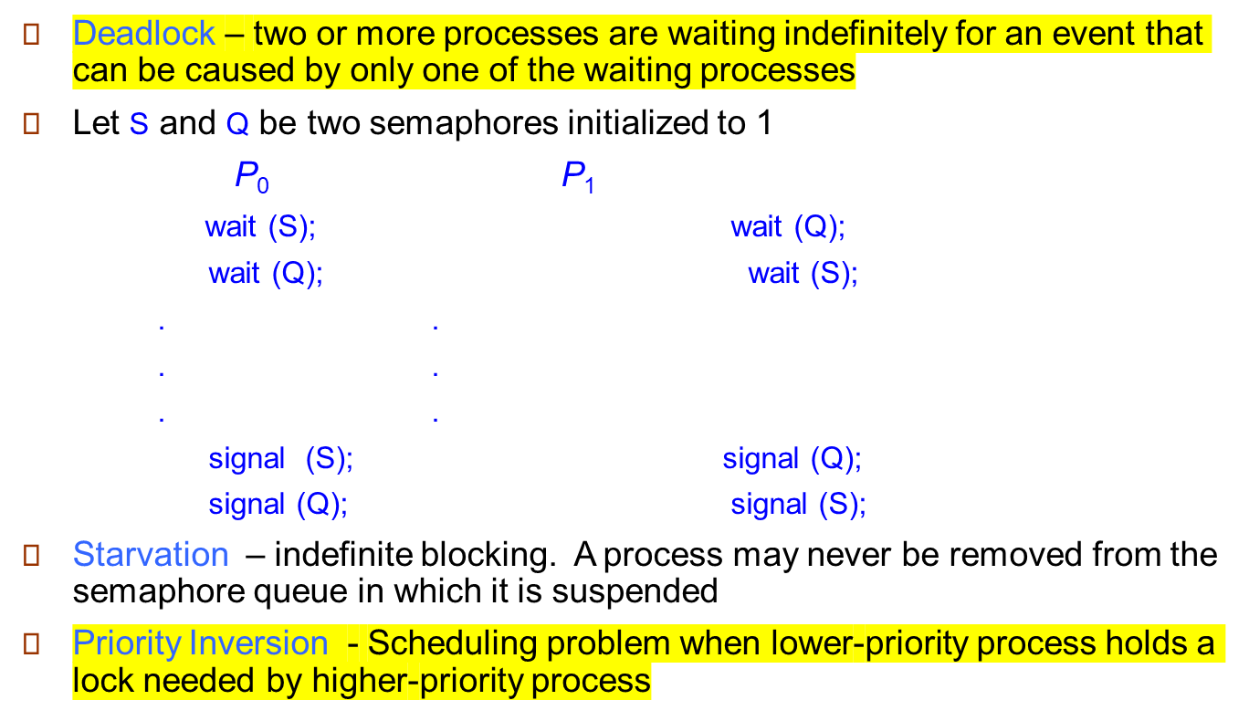
Deadlock and Starvation

Slide 17

Bounded-Buffer Problem
Readers and Writers Problem
Dining-Philosophers Problem

Slide 18

Dining-Philosophers Problem
Shared data
  Bowl of rice (data set)
  Semaphore chopstick [5] initialized to 1

Slide 19
Dining-Philosophers Problem (Cont.)
The structure of Philosopher i:
    do {
    wait ( chopstick[i] );
    wait ( chopStick[ (i + 1) % 5] );
    // eat
    signal ( chopstick[i] );
    signal (chopstick[ (i + 1) % 5] );
    // think
    } while (TRUE);

Slide 20
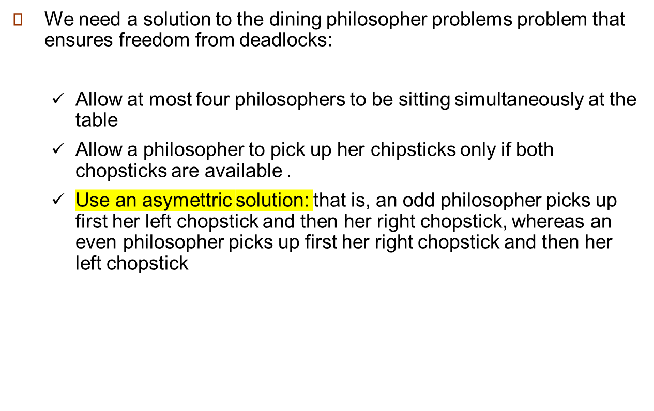
Dining-Philosophers Problem (Cont.)

Slide 21
End of Chapter 6

